Slide 1


FETCH AND
CARE

Slide 2



PRESENTED BY:
GARCIA, CATHERINE MAE
COMIA, PAUL ANGELO
ALMENANZA, DIANNE

Slide 3


Fetch and care
INTRODUCTION

Slide 4
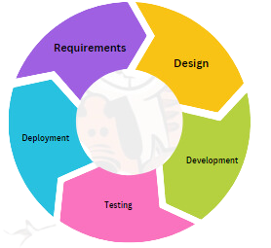

Development Model
Figure shows the Agile Application Development method that the researchers used. The agile method helps the researchers handle their work efficiently and effectively. The agile method is suited for the study; it is considered one of the most successful development models since it allows development to go through infinite numbers of cycles and allows continuous improvement.

Slide 5
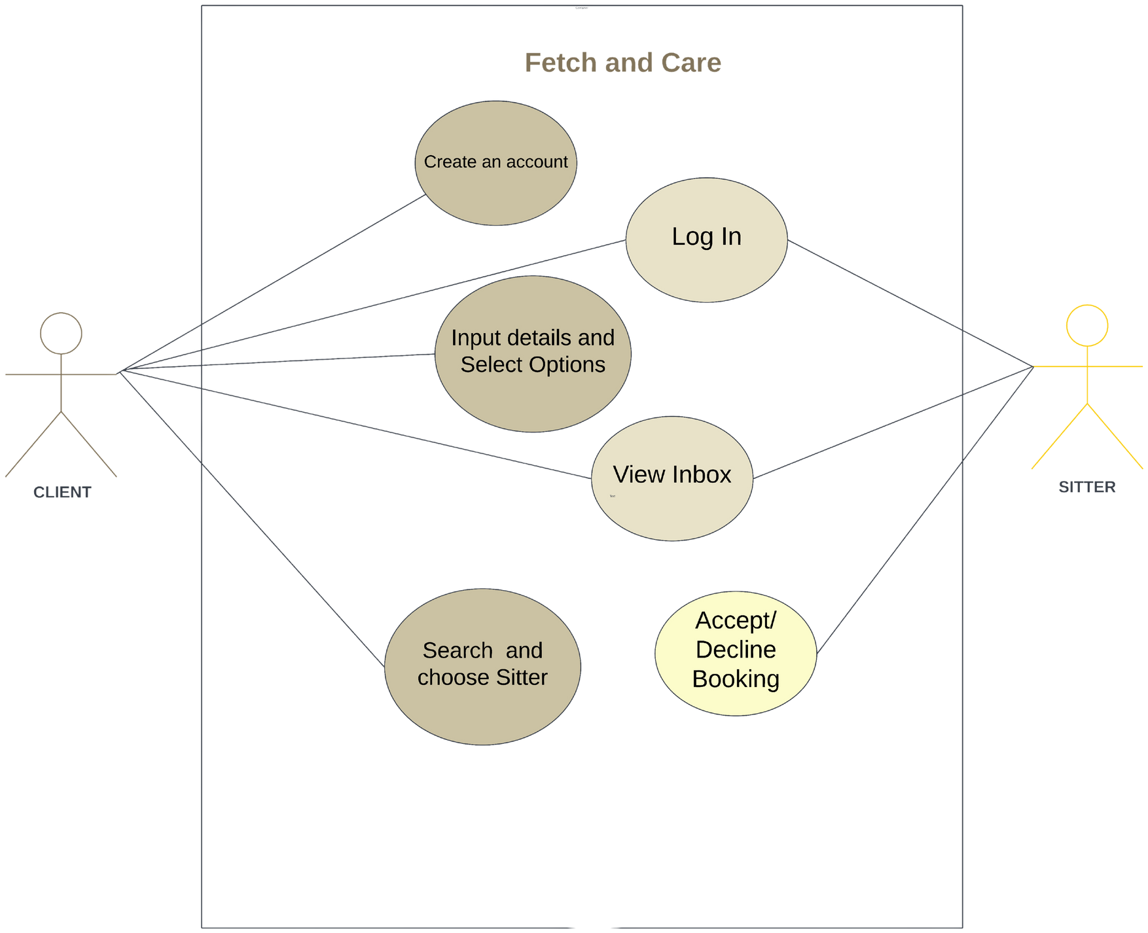
Use Case Diagram
System Architecture

Slide 6
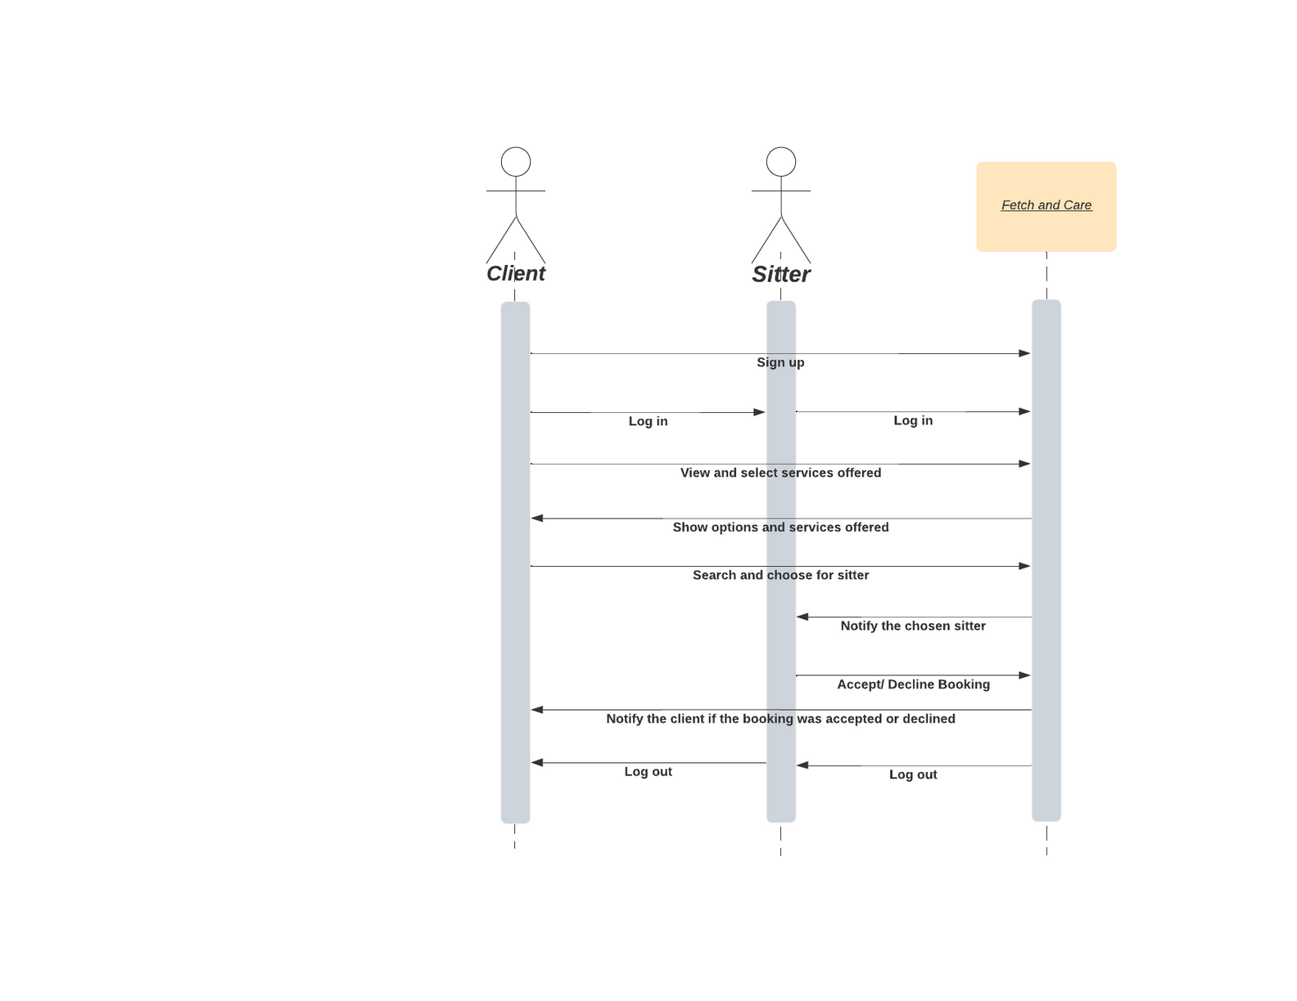
Sequence Diagram
System Architecture

